Slide 1
Presentation to the Board of Education
May 21, 2019

Slide 2
OUTCOMES FOR TONIGHT’S DISCUSSION
An overview of the Strategic Partnerships Team
An understanding of what "The Fund for Portland Public Schools" will do to support students and our school communities.
Answers to “What does the shift from All Hands Raised to The Fund for PPS mean for our local school community fundraising efforts?”
Begin discussing the current strengths and challenges of local school foundations, and further ideas for continuous improvement of these entities. This includes a preliminary review of the engagement plan for our community effort to “look under the hood.”

Slide 3
THE STRATEGIC PARTNERSHIPS TEAM

Slide 4
THE STRATEGIC PARTNERSHIPS TEAM
The Strategic Partnerships Team’s core function is to create, coordinate and facilitate public, private, and philanthropic partnerships that foster opportunities and benefits for students of PPS.
Lead a visioning process, a citywide movement that engages the social, financial and political capital of a broad range of stakeholders to systematically transform PPS over the next decade.
Develop meaningful, long-lasting dynamic partnerships with local and regional government, community colleges and universities, non-profit entities, corporations, philanthropists and others to enrich the educational experience of PPS students.
Develop and implement a comprehensive fundraising plan, financial revenue forecasting and blueprint for stewardship of external investments.
Devise and implement systems and policies for ethically, efficiently and equitably pursuing and stewarding private financial investments and competitive government funding.
Build a culture of philanthropy and volunteerism throughout PPS and Portland.
18-MONTH STRATEGIC PRIORITIES
1
2
3
4
5

Slide 5
Stephanie Soden
Executive
Chief of Staff
ORGANIZATIONAL CHART
Marvin Reyes
Confidential Executive Assistant
Jonathan Garcia
Chief Engagement Officer
The Fund for Portland Public Schools Board of Directors
Office of Strategic Partnerships (Fund Development)
Tullan Spitz
Manager, Stewardship & Donor Relations
Camille Idedevbo
Corporate/Foundations Relations Officer
Robyn Faraone
Manager,
School Partnerships
Office of Student, Family & Community Empowerment
TBD
Program Coordinator
TBD
Director, Community Engagement
Legend
Existing Positions
Transferred
Need to Hire
TBD
Student Engagement Manager
Rosie Fiallo
Manager, Communications and Public Affairs
Cameron Vaughn
Manager, Communications and Public Affairs

Slide 6
THE FUND FOR
PORTLAND PUBLIC SCHOOLS

Slide 7
A BRIEF HISTORY OF LOCAL SCHOOL FOUNDATIONS IN PPS
1994
Portland Schools Foundation Established
After the passage of Measure 5 in 1990, private fundraising in public schools escalates. A new policy to manage the parent investments established by the PPS School Board in May 1994.
2009
Award Process Changes
The PPS Parents’ Equity Fund process switches from subjective applications to a transparent, data-driven formula in order to distribute funds more fairly to PPS schools most in need.
2017
Supt. Guerrero Joins PPS
In October 2017, Superintendent Guadalupe Guerrero is selected by the PPS Board of Education as Superintendent and establishes the Office of Strategic Partnerships.
1998
Updated Guidelines Approved by PPS Board
PPS School Board adopts updated guidelines for fundraising efforts of PSF and LSFs.
2008
Work Grows to Include Seven School Districts
PSF broadens to incorporate seven school districts as partners.
2011
Name Changes to All Hands Raised
Motivated by Multnomah County Superintendents and through conversations with hundreds of stakeholders, PPSF is rebranded as All Hands Raised to reflect the newly-expanded footprint and the philosophy of a community-wide, integrated approach. PSF becomes a subdivision of AHR.
2019
The Fund for PPS Established
In order to coordinate fundraising efforts across PPS, The Fund for PPS is established. PSF efforts merge with The Fund.
PPS Vision Created
A community and future informed vision to reimagine public education in Portland is created with thousands of community stakeholders.
2007
Raise Fund Exemption
After an Equity Fund Review Committee convenes in 2007, they recommend to the PPS Board to increase the current exemption from $5,000 to $10,000.

Slide 8
A NEW VISION FOR PORTLAND PUBLIC SCHOOLS
In the fall of 2018, we launched an ambitious process to develop a community informed vision for the future of public education in Portland.
This vision--our District’s promise to the community--will require a well-coordinated effort encouraging students, families, community, business, philanthropic, and civic leaders to feel inspired and take action to support, contribute and hold ourselves accountable for better outcomes for every public school student in PPS.
The PPS Vision will include:
Our community’s guide for PPS’s transformation
Graduate Portrait
Educator Essentials
Educational System Shifts
Core Values
The Fund for Portland Public Schools will serve as the primary driver of galvanizing philanthropic partners to invest in PPS.

Slide 9
STRATEGIC PARTNERSHIPS & COMMUNITY INVESTMENTS
ARE CRITICAL TO ACCELERATE PROGRESS AT PPS
City of Portland & Multnomah County
Business Sector
Portland Public Schools
Broader Community
Philanthropic Community
Align strategic efforts, innovative thinking and business/philanthropic/community resources…
…to ensure that Portland Public School students have the opportunity to thrive and to graduate with a sense of self, prepared for success in life, work and study.

Slide 10
TIERED LEVELS OF PARTNERSHIPS AND FUNDRAISING EFFORTS
The Fund for PPS will build connections between the District and the community to foster a culture of engagement and investment in public education that will (1) drive financial, in-kind and human capital resources to district priorities; (2) leverage data and insights to drive innovation, change and shared value.
Committed Generosity Network
Culture of Philanthropy and Innovation
Clear Strategic Direction & Alignment
Excellent Customer Service
Systemic Accountability
Lead with Racial Equity and Social Justice
High-Level Investments:
Multi-Year, Multi-Million, Districtwide ($1M+)
Mid-Level Investments:
Districtwide Priority ($100K - $999K)
Entry-Level Investments:
School Site / Departmental Priority ($1K - $99K)
High Leverage Volunteerism, Student Experiences, Student Internships, Resources. (non-monetary)

Slide 11
THE FUND FOR PORTLAND PUBLIC SCHOOLS
The Fund for PPS will serve as the backbone nonprofit organization solely focused on strengthening and expanding private and philanthropic investments on behalf of the District.
These investments will be closely aligned to PPS’ core vision, strategic plan and critical content areas.
In close coordination with the District’s leadership, The Fund for PPS will serve as the primary (not exclusive) vehicle for creating, coordinating and facilitating public, private, and philanthropic partnerships that foster equitable opportunities and benefits for students of PPS.
It will also be responsible for stewarding, augmenting and supporting local school foundation efforts across PPS.

Slide 12
THE FUND FOR PORTLAND PUBLIC SCHOOLS
Build Our “Generosity Network”
Leverage the assets of various influential philanthropic and community leaders (Board of Directors), cultivating, soliciting and stewarding high-impact philanthropic investors and strategic partners that promote a bold, innovative and comprehensive K-12 education system in Portland.
Steward Strategic Investments and Augment Local School Foundation Efforts
Establish and nurture long lasting collaborative relationships between PPS, a robust portfolio of philanthropic investors and strategic partners and our school communities.
Robust Accountability Structures and Transparent Financial Records
Develop robust accountability structures and transparent financial records, and will have an independent Board of Directors with direct oversight. We will also utilize existing internal operations to minimize operational and implementation costs.
1
2
3

Slide 13
THE FUND FOR PPS IS MODELED AFTER HIGHER EDUCATION FUNDRAISING MODELS
As an example, The University of Oregon Foundation is the 501(c)(3) auxiliary organization of the University of Oregon that coordinates financial investments to assist the university in meeting its educational mission.
The University Advancement Team at the University of Oregon leads these efforts to create awareness, build long-term relationships and facilitate charitable giving.

Slide 14
THE OPERATIONS OF THE FUND FOR PPS
Governance: Board of Directors representing the diverse philanthropic and business community of Portland.
Location: Headquartered at BESC (PPS Central Office). The Operational Agreement will detail “use of facilities.”
Staffing: Activities will be executed by existing PPS Strategic Partnerships team (i.e. $4.5 Million raised in grants between Jan. 2018 - Current). There will be one full time staff coordinating LSF supports. This position will be supported in part by private investments.
Relationship with PPS: An Operational Agreement will be developed between the two entities, establishing responsibilities, expectations and annual allocation and cost reimbursements associated with operating The Fund for Portland Public Schools.
Relationship with All Hands Raised: We will work closely with AHR to ensure little to no interruption of services through transition. Moreover, The Fund for PPS, in close coordination with PPS leadership, will identify tangible ways to continue partnership efforts with AHR, which serves as convener of entities across Multnomah County.

Slide 15
STEWARDSHIP OF
THE LOCAL SCHOOL FOUNDATIONS

Slide 16
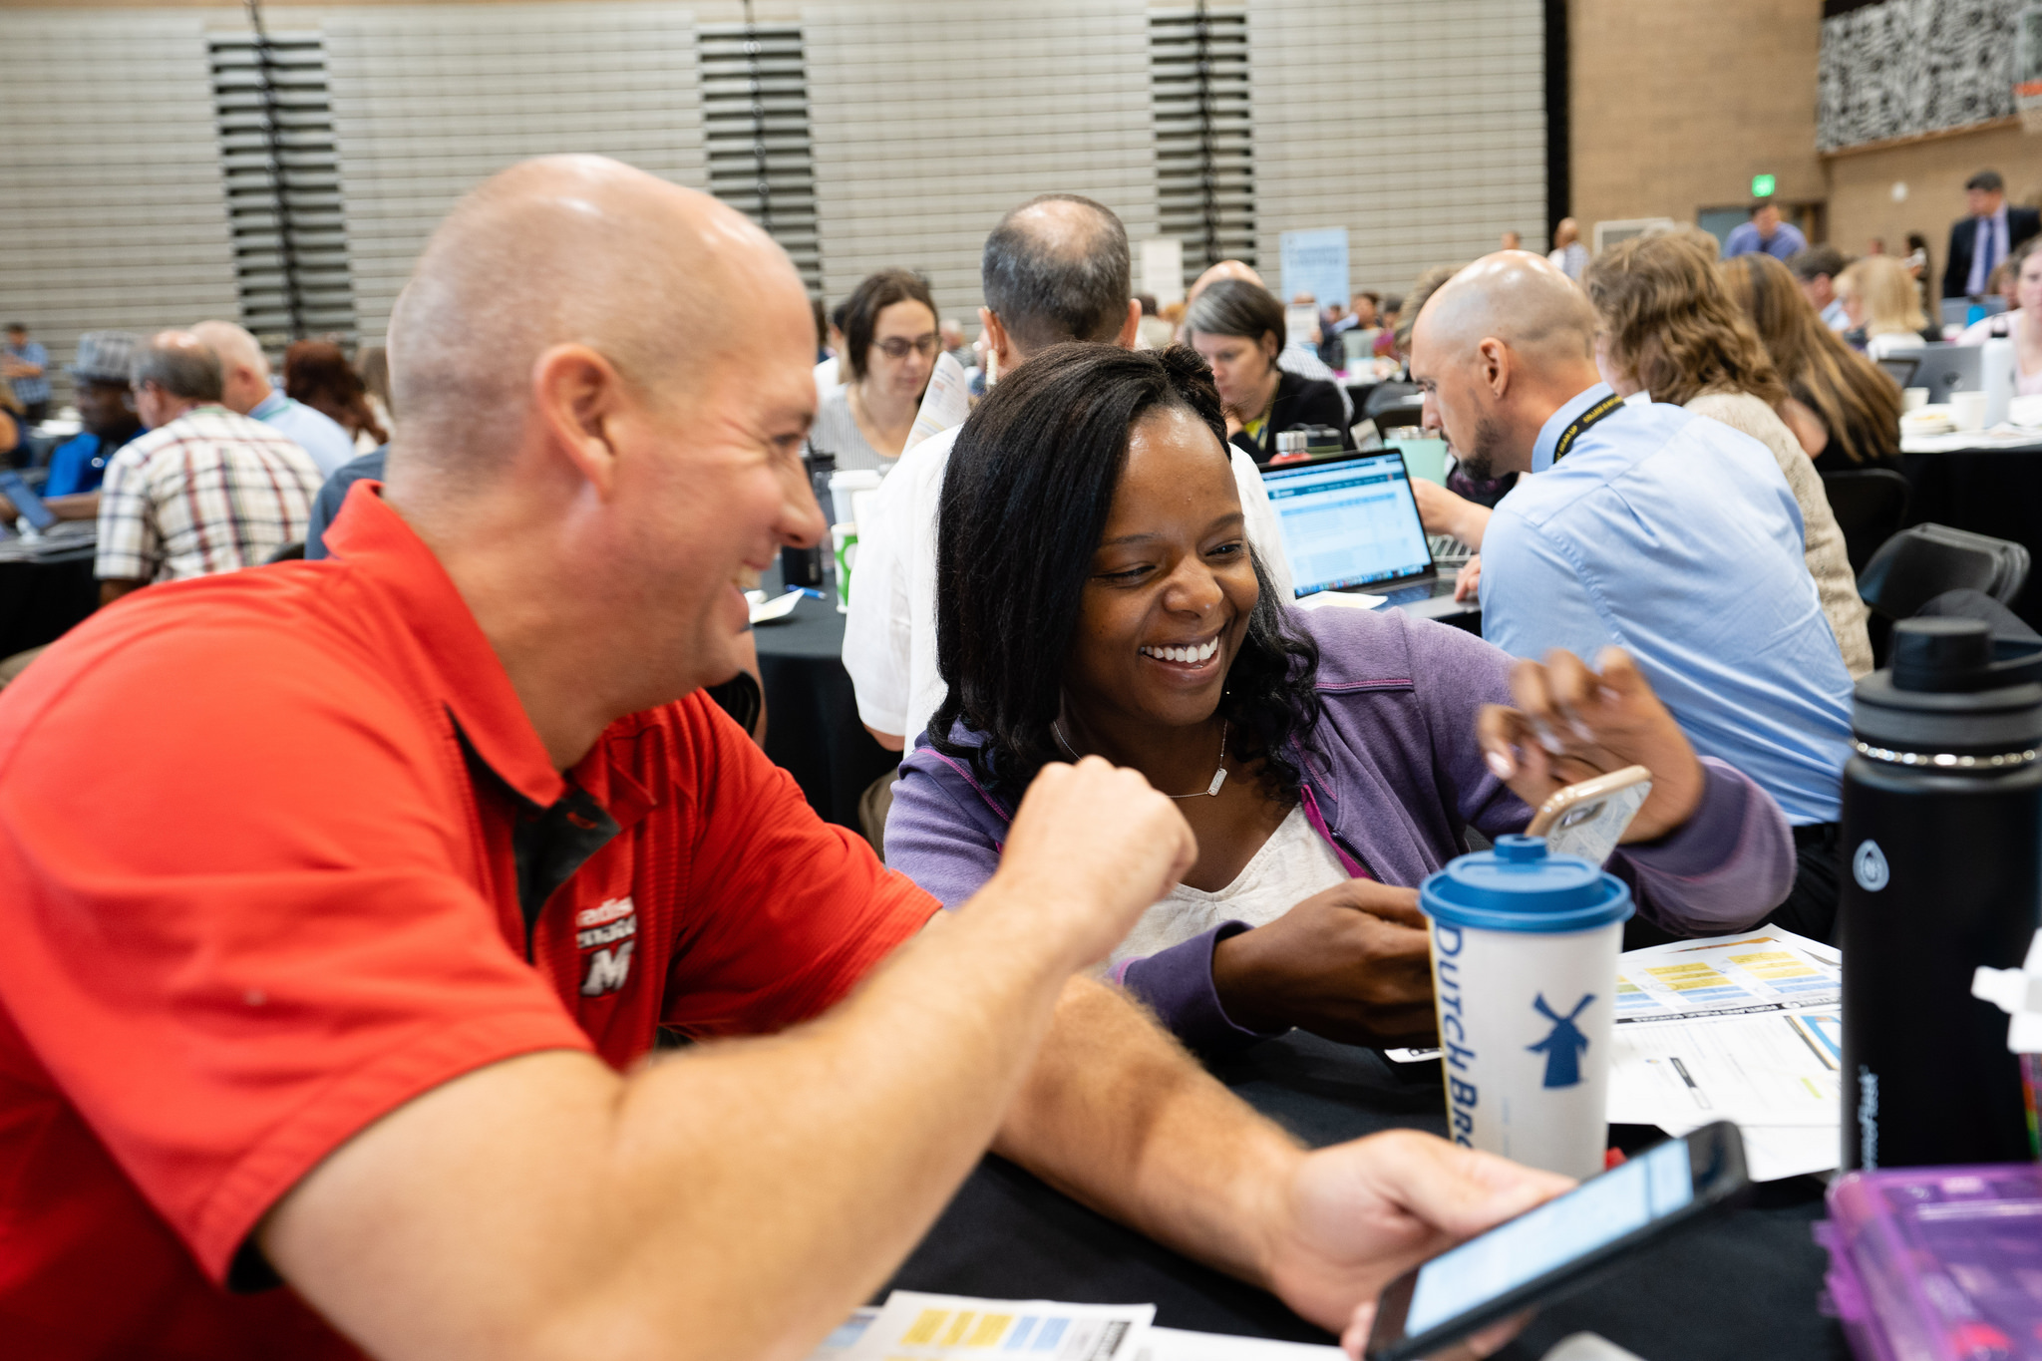
STEWARDING PPS’ LOCAL SCHOOL FOUNDATIONS
Under PPS Board of Education Policy and the adopted guidelines, all PPS schools have the support to operate a Local School Foundations (LSFs).
Today, 42 school communities have active LSFs, including 8 that operate independent foundations.
The Fund for PPS will provide excellent customer service and support to maximize fundraising efforts.
As a guiding principle, The Fund for PPS and Portland Public Schools will honor and value donor intent.
Utilizing a Racial Equity and Social Justice Lens, we plan to institute an effort to activate and provide intentional support to school communities in their fundraising efforts. This includes the establishment and roll-out of an “Adopt a School” program to encourage small-, mid- and corporate size companies to volunteer and invest in our schools.

Slide 17
IMPACT OF FUNDRAISING EFFORTS BY LSFs
Local School Foundations (affiliated and independent) are exclusively allowed to raise dollars for staffing. Below is an overview of the four years of dollars raised and its FTE equivalent.
 | 2014-2015 | 2015-2016 | 2016-2017 | 2017-2018
Funds Raised by LSFs (in Dollars)
School Portion ($10,000 + 2/3 contribution) | $2,375,924 | $2,337,206 | $2,599,580 | $2,942,911
PPS Parent Fund (1/3 contribution) | $1,001,2701 | $980,990 | $1,111,735 | $1,276,364
Total $ in School Staffing | $3,377,195 | $3,318,197 | $3,711,315 | $4,219,276
School Staffing (in FTEs)
Classified – Represented | 19.58 | 22.48 | 11.86 | 25.66
Licensed Staff | 21.64 | 22.71 | 25.63 | 29.74
Non-Represented Staff | 0.60 | 0.96 | 1.13 | 0.20
Grand Total (Full Weighted) | 41.82 | 46.15 | 38.62 | 55.60
Total w/ Classified Weighted* | 32.03 | 34.91 | 32.69 | 42.77
* Total w/ Classified Weighted counts classified FTE at .5 FTE because they are paid about 50% of the other positions.

Slide 18
THE SUPPORT LSFs WILL RECEIVE FROM US WILL INCLUDE:
Financial Operational Support
Process all gifts in accordance with IRS Guidelines
Filing of the IRS 990
Processing of contributions, including checks, credit cards, monthly contributions*, in-kind gifts, share of stocks and real property.
Technical and Operational Assistance
Legal liability rests with The Fund’s Board of Directors
Maintain a comprehensive database of donors (transferred from AHR)
Use of The Fund’s raffle and alcohol license for auctions and other events
Coverage under The Fund’s general liability insurance
Use of The Fund’s bulk mail permit
Augmented trainings and supports in your fundraising efforts
* We are currently working with AHR to provide a seamless transition for these monthly online contributions.

Slide 19
THE PPS PARENT FUND
The PPS Parent Fund serves as a set aside of the one third raised by Local School Foundations. These funds are stewarded and distributed to high-need schools using a data-driven formula.
For the 2019-2020 school year, The PPS Parent Fund allocations were done by All Hands Raised. Moving forward, The Fund for PPS will, through a community engagement process, partner with PPS parents and community to look at various processes, including formula, to determine areas that could be strengthen.

Slide 20
2019-20 PPS PARENT FUND AWARDS

Slide 21
2019-20 PPS PARENT FUND AWARDS

Slide 22
2019-20 PPS PARENT FUND AWARDS

Slide 23
SO, WHAT EXACTLY WILL BE DIFFERENT? FOR NOW, VERY LITTLE
For now, we hope to execute a seamless transition between All Hands Raised, PPS and The Fund for PPS.
Between now and August 2019, we do not plan to focus on making policy and/or administrative changes.
TheFundforPPS.org will serve as our primary site for documents, monthly donations, announcements, etc.
A Program Coordinator will be hired and serve as a primary day to day support related to Local School Foundations. In the meantime, schools’ point of contact will be Robyn Faraone, PPS’ School Partnerships Manager.

Slide 24
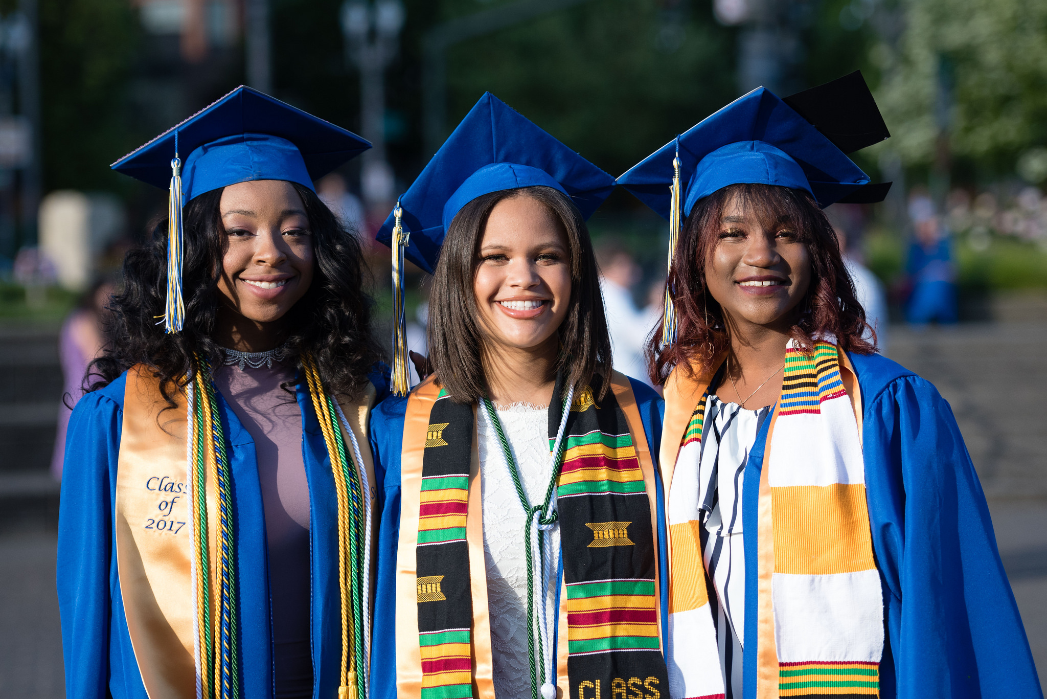
WHAT’S NEXT?
Portland Public Schools, in close partnership with All Hands Raised, will continue the process of transferring administrative responsibilities of the Local School Foundations.
Between now and July 1, 2019, LSFs will continue to work with All Hands Raised (deposit funds, receive monthly financial reports, support with auction efforts, etc.). After July 1, 2019, those responsibilities will be in the hands of The Fund for PPS.
We will be providing regular updates via email and on our webpage, FundforPPS.org.

Slide 25
WHAT’S NEXT?
We also welcome all PPS LSF Parent Leaders to our inaugural half-day convening on Saturday, September 28, 2019 (proposed), where we will share best practices and support your fundraising efforts in the new school year.
More details forthcoming.
We plan to engage the parent and broader community in a series to “look under the hood” of the Local School Foundations, PPS Parent Fund, etc. beginning in the Fall 2019. Any proposed changes for 2019-20 will be finalized by December 31, 2019.

Slide 26
BOARD OF EDUCATION
DISCUSSION

Slide 27
YOUR FEEDBACK IS IMPORTANT DURING AND AFTER THIS TRANSITION
Strengths:
What do we
value about LSFs?
Challenges:
What are concerns regarding how LSFs operate that we should look into?
The Fund for PPS:
How can we support the success of every PPS school,
LSF, PTA and of every student?

